Slide 1

Juniors Level 1

Slide 2
اللهم اجعل هذا العمل خالصا لِوَجْهِكَ الكريم

Slide 3
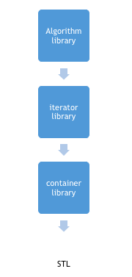
Standard Template Library (again)
STL is an acronym for standard template library. It is a set of C++ template classes that provide generic classes and function that can be used to implement data structures and algorithms STL is mainly composed of :
Containers
Algorithms
Iterators

Slide 4
C++: Non Liner Data structure
Associative containers Associative containers : implement sorted data structures that can be quickly searched (O(log n) complexity).
Set: Collection of unique keys, sorted by keys (class template)
Map: Collection of key-value pairs, sorted by keys, keys are unique (class template).
multiset: Collection of keys, sorted by keys (class template)
multimap: Collection of key-value pairs, sorted by keys (class template)

Slide 5
C++: Non Liner Data structure
Unordered associative containers Unordered associative containers : implement unsorted (hashed) data structures that can be quickly searched (O(1) amortized, O(n) worst-case complexity).
unordered_set: Collection of unique keys, hashed by keys. (class template)
unordered_map: Collection of key-value pairs, hashed by keys, keys are unique. (class template)
unordered_multiset: Collection of keys, hashed by keys (class template)
unordered_multimap: Collection of key-value pairs, hashed by keys (class template)

Slide 6
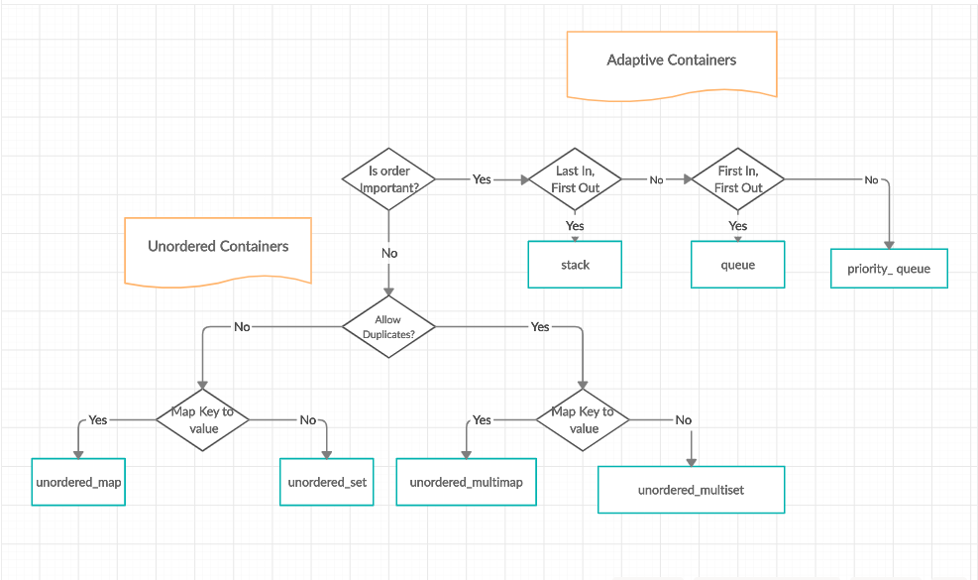
C++: Non Liner Data structure

Slide 7
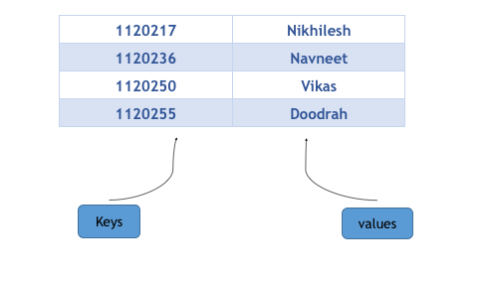
Map in C++ Standard Template Library (STL)
Maps are used to replicate associative arrays.
Maps contain sorted key-value pair, in which each key is unique and cannot be changed, and it can be inserted or deleted but cannot be altered. Value associated with keys can be altered. We can search, remove and insert in a map within O(log(n)) time complexity.

Slide 8

Creating a Map in C++ STL
Maps can easily be created using the following statement :
This will create a map with key of type Key_type and value of type value_type. One thing which is to remembered is that key of a map and corresponding values are always inserted as a pair, you cannot insert only key or just a value in a map.

Slide 9
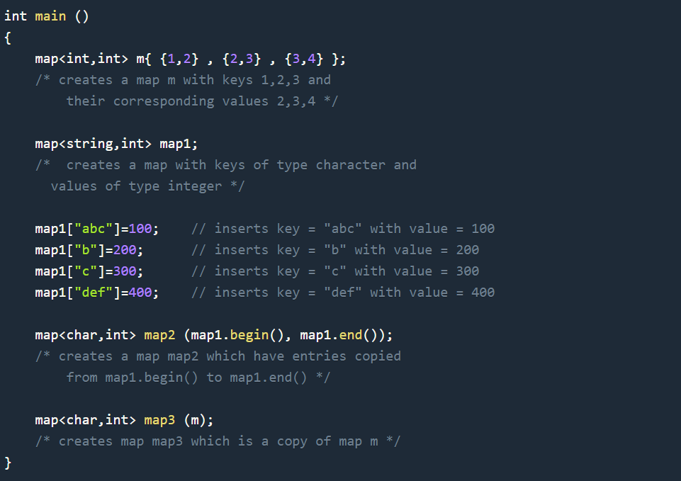
Creating a Map in C++ STL

Slide 10
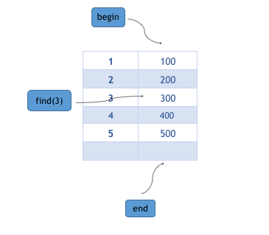
Member Functions of Map in C++ STL
insert
erase
begin
end
count
find
iterate over it
Clear
LINK_CODE

Slide 11
unordered_map in C++ STL(STL)
unordered_map is an associated container that stores elements formed by combination of key value and a mapped value. The key value is used to uniquely identify the element and mapped value is the content associated with the key. Both key and value can be of any type predefined or user-defined.
Internally unordered_map is implemented using Hash Table, the key provided to map are hashed into indices of hash table that is why performance of data structure depends on hash function a lot but on an average the cost of search, insert and delete from hash table is O(1).

Slide 12
Problem
Given a string of words, find frequencies of individual words.
Ex :
(input) : You are the world and the world is you.
(out) :
you : 2
are : 1
the : 2 … etc

Slide 13
Set in C++ Standard Template Library (STL)
Sets are a type of associative containers in which each element has to be unique, because the value of the element identifies it. The value of the element cannot be modified once it is added to the set, though it is possible to remove and add the modified value of that element.
insert
begin
end
erase
find
Size
LINK_CODE

Slide 14
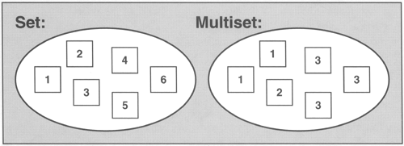
Multiset
Multisets are a type of associative containers similar to set, with an exception that multiple elements can have same values. Some Basic Functions associated with multiset:
Take care when using erase ^^

Slide 15
Break..
A frog fell into a well 10 feet deep. He could jump 2 feet, but every time he jumped 2 feet, he fell back 1 foot. How many times did he have to jump to get out of the well?

Slide 16

Sorting
Time complexity
Counting Sort
Merge Sort
Merge Problem

Slide 17
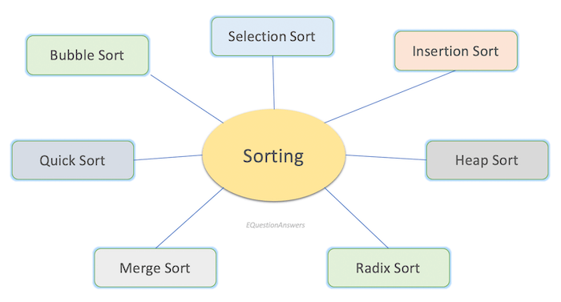
Sorting

Slide 18
Sorting
Bubble sort (N^2) compare all
Insertion sort (N^2)
Selection sort (N^2)
Merge sort (N log N)
Counting Sort ( N )
Quick Sort (N log N)

Slide 19
Merge Sort
Like QuickSort, Merge Sort is a Divide and Conquer algorithm.
It divides the input array into two halves, calls itself for the two halves, and then merges the two sorted halves. The merge() function is used for merging two halves. The merge(arr, l, m, r) is a key process that assumes that arr[l..m] and arr[m+1..r] are sorted and merges the two sorted sub-arrays into one.

Slide 20
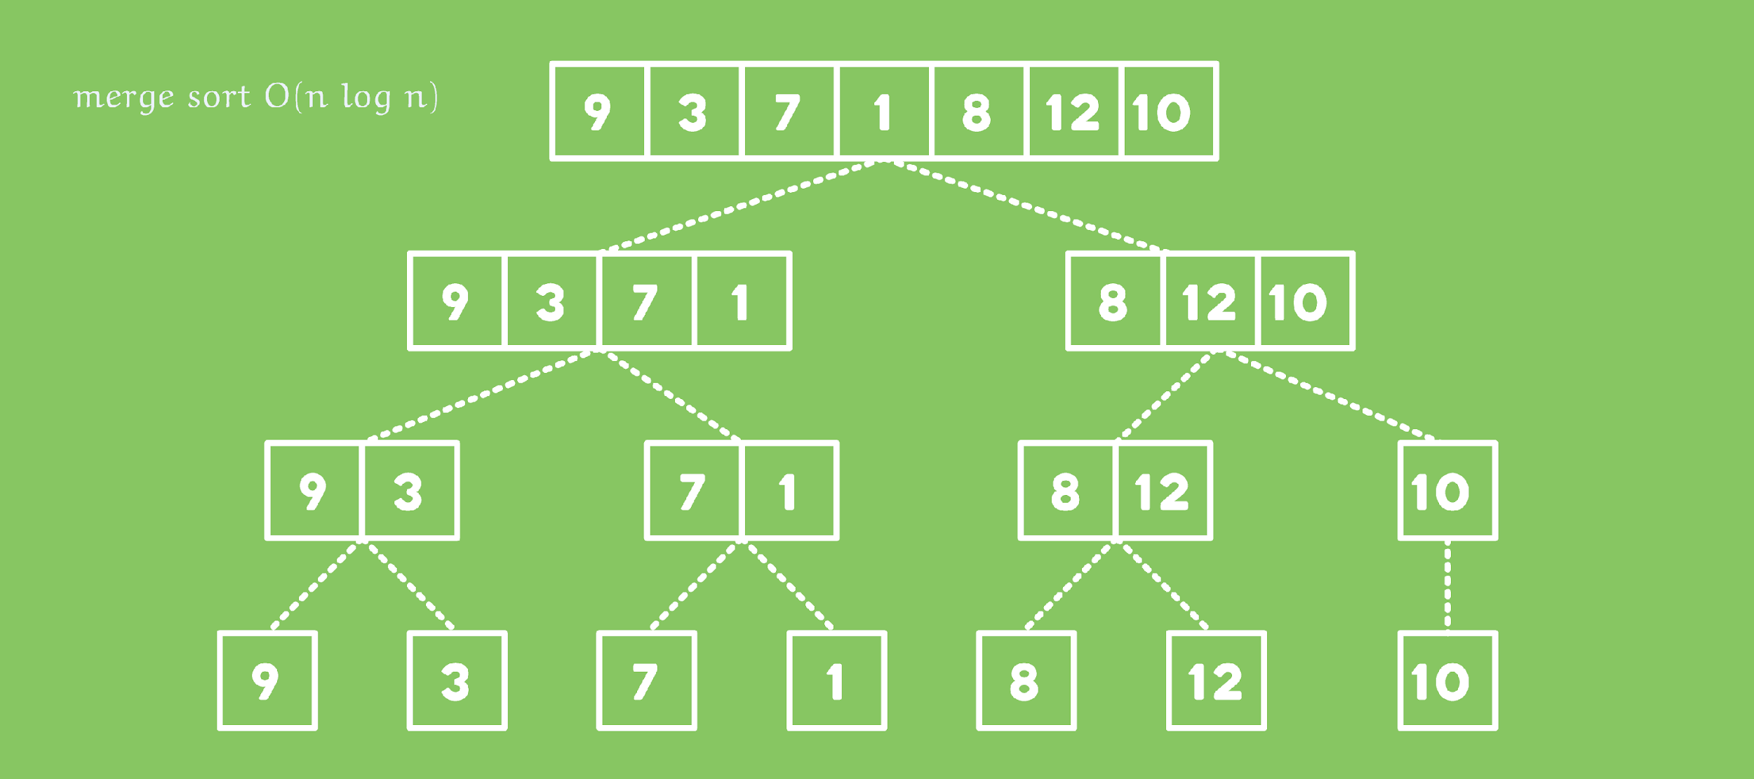
Merge Sort

Slide 21
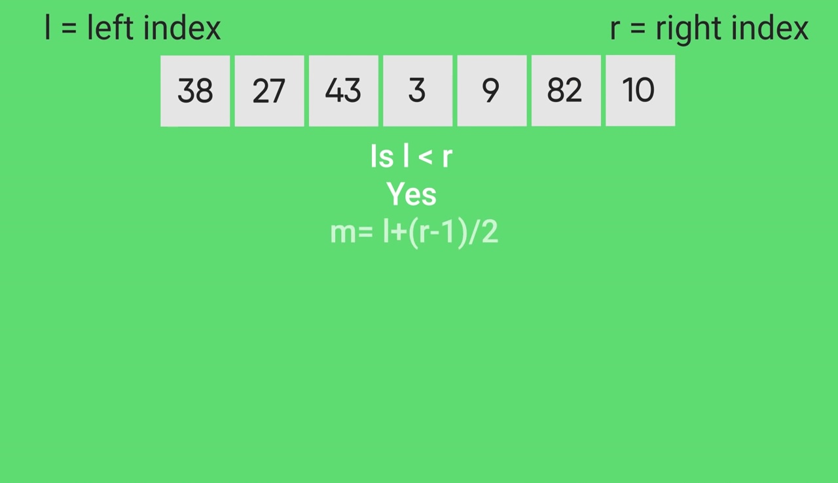

Slide 22
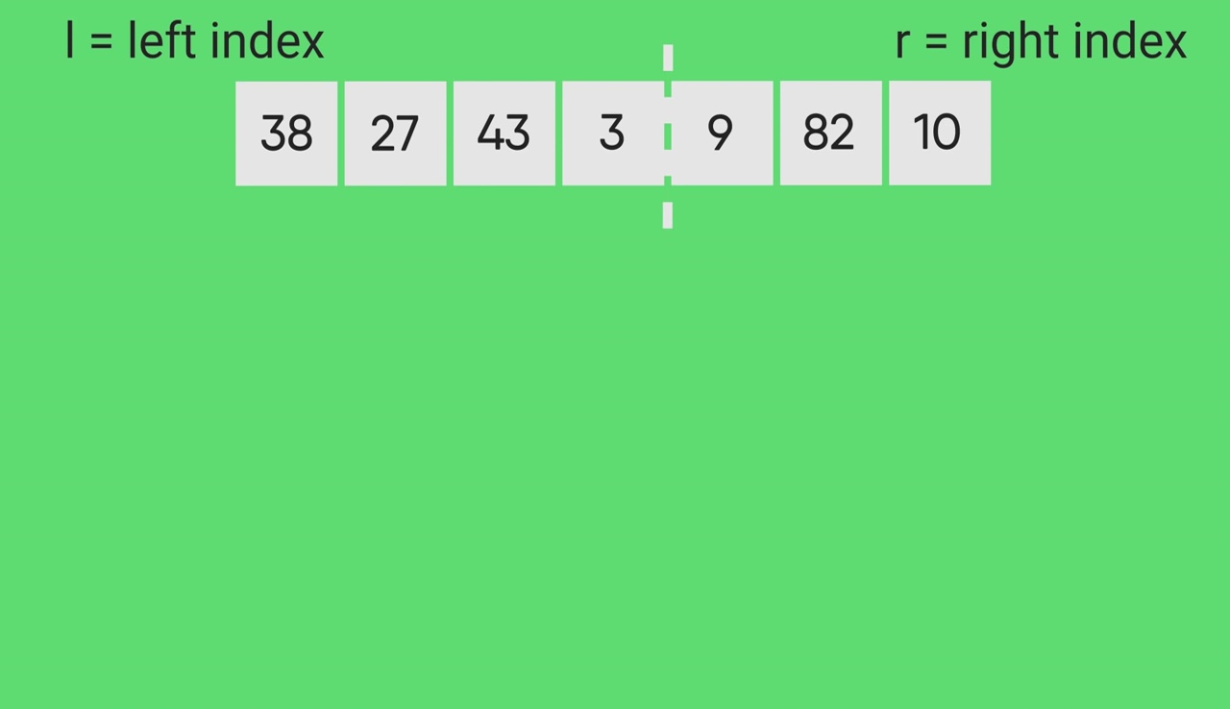

Slide 23
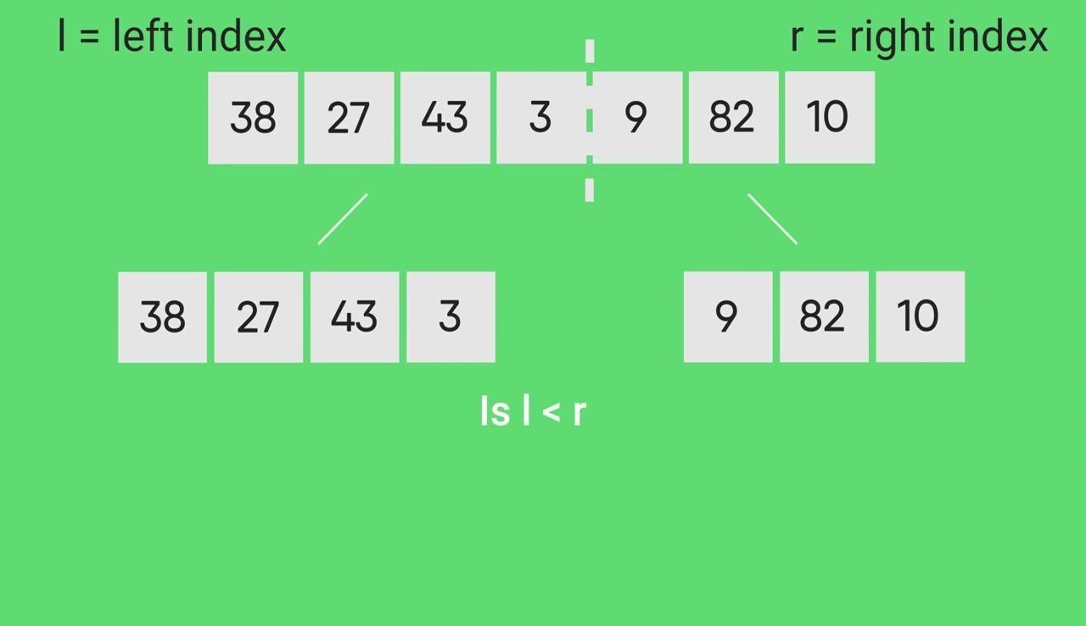

Slide 24
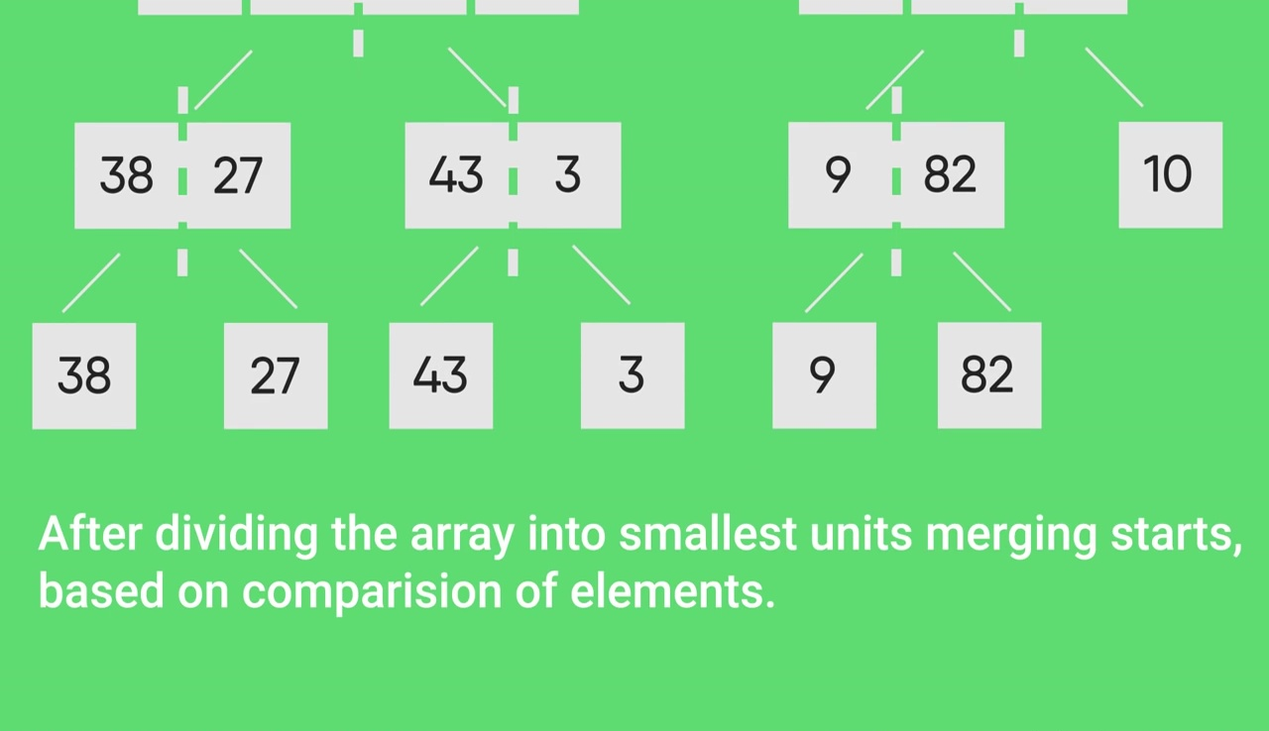

Slide 25
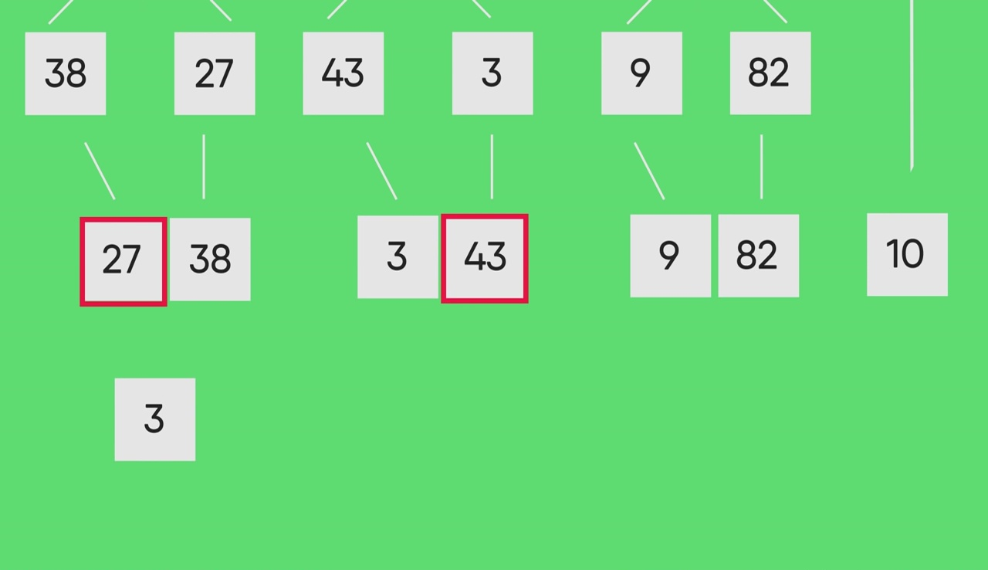

Slide 26
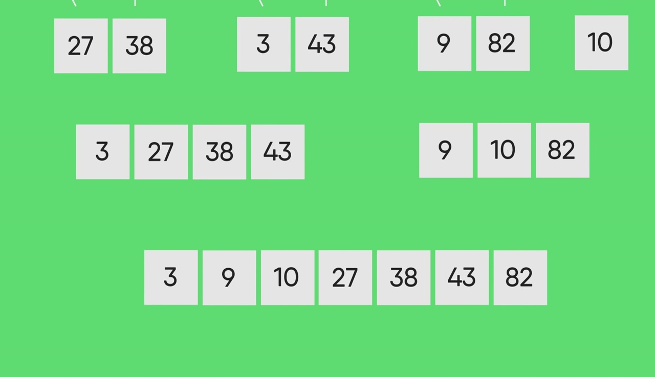

Slide 27
Merge Sort
MergeSort(arr[], l, r)
If r > l
1. Find the middle point to divide the array into two halves:
middle m = (l+r)/2
2. Call mergeSort for first half:
Call mergeSort(arr, l, m)
3. Call mergeSort for second half:
Call mergeSort(arr, m+1, r)
4. Merge the two halves sorted in step 2 and 3:
Call merge(arr, l, m, r)
Code

Slide 28

دورك بقي ..

Slide 29
Problem
Given two arrays try to merge them in one array with sorted order.

Slide 30
IQ question for interview?
When 1 + 1 = 10 !!

Slide 31
Comparison Functions
in general : you can only sort a collection of objects if you can tell whether an object must come before another, so it is important to learn how to define an ordering in a class.
Ex : Code

Slide 32
Problem
Given an array of size N sort it in way that all even numbers come before odd.

Slide 33

واحدة كمان ^^
Problem_LINK - sol

